Slide 1

PREDICTIVE MAINTENANCE IN MACHINE TOOLS

Slide 2

1
Introduction
Contents
2
Problem Statement
3
Abstract
4
Domain Knowledge
5
Approach
6
Dataset
7
Key Stakeholders
8
Use Case Diagram
9
References

Slide 3

Introduction
In today's rapidly evolving industrial landscape, machine tools serve as the backbone of manufacturing operations across various sectors. These sophisticated devices play a pivotal role in shaping the efficiency and productivity of production lines. However, like any mechanical system, machine tools are susceptible to wear and tear, breakdowns, and inefficiencies that can disrupt operations and incur substantial costs.
Traditional maintenance practices often rely on reactive or scheduled approaches, leading to unexpected downtime, costly repairs, and compromised productivity. In contrast, predictive maintenance (PdM) has emerged as a proactive strategy aimed at mitigating these challenges by harnessing the power of artificial intelligence (AI) and advanced analytics. This introduction delves into the realm of predictive maintenance for machine tools, exploring how AI technologies revolutionize maintenance strategies, enhance operational efficiency, and drive significant cost savings for manufacturing enterprises.

Slide 4

Problem Statement
The current approach to maintenance of machine tools in manufacturing industries often relies on reactive or scheduled maintenance practices, leading to inefficiencies, unplanned downtime, and increased maintenance costs. There is a lack of proactive strategies to predict and prevent equipment failures before they occur, resulting in lost production time and reduced overall equipment effectiveness (OEE). Additionally, traditional maintenance approaches may result in unnecessary component replacements, leading to higher operational expenses and resource wastage.

Slide 5

Abstract
In order to forecast machine maintenance, this research encompasses an extensive process of machine failure dataset analysis and modelling. Numerous features, such as air temperature, process temperature, torque, rotational speed, tool wear duration, and several machine failure categories, define the dataset.
Significant positive connections between certain failure categories and the overall machine failure were shown by our exploratory data analysis, indicating that these failures frequently occur simultaneously. We also found that a higher torque could potentially increase the likelihood of a machine failing.
We used the AdaBoost model's capability to forecast machine faults. With careful tuning and cross-validation, the model achieved an outstanding average score of 0.996.
The model's strong capacity to distinguish between positive and negative classes was demonstrated during the testing phase, when it demonstrated an accuracy of 0.997 and an AUC score of 0.90. Nonetheless, the model produced 91 errors in total, suggesting possible areas for improvement.
This project highlights how machine learning may be used to predict machine breakdowns, which might have a significant impact on improving operational efficiency and preventive maintenance in a variety of industries. Subsequent research projects may investigate additional error analysis, model testing, feature engineering, and more thorough hyperparameter tuning.

Slide 6

This is a special number that belongs to every dataset entry. It doesn't add anything to the predictive model, but it is helpful for monitoring specific data points.
Features id
Domain Knowledge
This unique identifier for the particular machine or product may help determine whether some equipment is more likely to break down than others.
Product id
The chance of failure may vary depending on the kind of machine or equipment. The failure rates of various machine types could vary.
Type
These values may be important in anticipating machine failure. A common reason for machine failure is overheating.
Temperature of air
Rotational Speed
Another potential cause of machine failure is the machine's rate of rotation. High-speed machines may have a higher failure rate.
The machine's applied rotational or twisting force may be a factor in wear and tear and eventual machine failure.
Torque
The amount of time spent using a tool may be a reliable indicator of when a machine may break. Longer-term users are more likely to have tool failure.
Tool Wear
Our goal variable is machine failure. It is a binary indicator that shows if there was a machine failure or not.
Tool Wear
The nature of the machine faults is fully disclosed by these binary indications for various failure categories. They might be helpful in developing a prediction model that is more complex.
Tool Wear

Slide 7
Approach
Data Loading and Preprocessing
Model Training
Exploratory Data Analysis
Load the data and preprocess it for analysis and modeling. This includes handling missing values, encoding categorical variables, and scaling numerical variables.
Explore the data to gain insights and understand the relationships between different features and machine failure.
Train the AdaBoost model on the preprocessed data.
Model Evaluation
Error Analysis
Future Work
Evaluate the model's performance using various metrics, such as accuracy and AUC score.
Analyze the instances where the model made errors to gain insights into potential improvements
Based on our findings, suggest potential directions for future work.

Slide 8

DataSET
The dataset we'll be working with has a number of attributes pertaining to machine faults and operations. With respect to rotational speed, torque, air temperature, and process temperature, each row corresponds to a distinct machine operation. Together with indicators for various failure kinds, it also has a binary indicator that indicates if the machine failed during that particular operation.

Slide 9
DATASET
Product ID: Identifier for the specific product/machine.
Type: Type of machine or equipment (L for Large, M for Medium, etc.).
Air temperature [K]: The temperature of the air surrounding the machine (measured in Kelvin).
Process temperature [K]: The temperature of the machine during the process (measured in Kelvin).
Rotational speed [rpm]: The speed of rotation of the machine in revolutions per minute.
Torque [Nm]: The rotational force or twisting force applied by the machine in Newton meters.
Tool wear [min]: The duration of tool usage in minutes.
Machine failure: A binary indicator (0 or 1) representing whether the machine experienced failure (1) or not (0).
TWF (Tool Wear Failure): Binary indicator (0 or 1) for tool wear failure.
HDF (Heat Dissipation Failure): Binary indicator (0 or 1) for heat dissipation failure.
PWF (Power Failure): Binary indicator (0 or 1) for power failure.
OSF (Overstrain Failure): Binary indicator (0 or 1) for overstrain failure.
RNF (Random Failure): Binary indicator (0 or 1) for random failure.

Slide 10
Maintenance Technicians/Engineers
Key StakeHolders
Operations Team
Manufacturing Managers/Supervisors
Finance Department
Data Scientists/Analysts
Quality Assurance/Quality Control (QA/QC) Team
IT Department
Health, Safety, and Environmental (HSE) Department
Equipment Suppliers/Vendors
Senior Management/
Executives

Slide 11
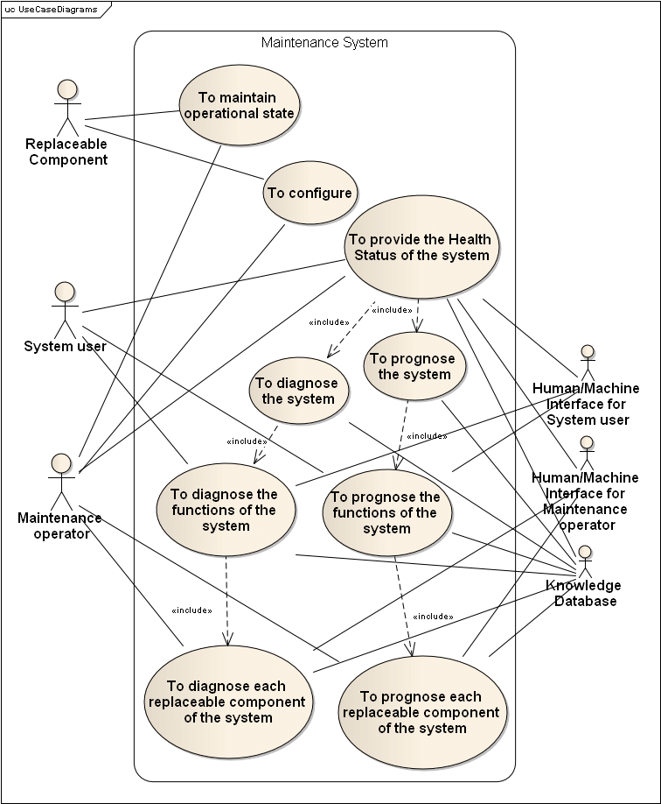
USECAse
Diagram

Slide 12

References
I. Wo Jae Lee, Haiyue Wu, Huitaek Yun, Hanjun Kim, Martin B.G. Jun, John W. Sutherland, “Predictive Maintenance of Machine Tool Systems Using Artificial Intelligence Techniques Applied to Machine Condition Data” in CIRP Conference on Life Cycle Engineering (LCE) Purdue University, USA, 2019.
II. Weichao Luo, Tianliang Hu, Yingxin Ye, Chengrui Zhang, Yongli Wei, “A hybrid predictive maintenance approach for CNC machine tool driven by Digital Twin“ in Shandong University, Jinan, P. R. China, 2019.
•III. Alberto Jimenez-Cortadi, Itziar Irigoien, Fernando Boto, Basilio Sierra andGerman Rodriguez, “Predictive Maintenance on the Machining Process and Machine Tool” in TECNALIA, Industry and Transport Division, Leonardo da Vinci, Miñano, Spain, 2019.

Slide 13
References
IV. Bernard Schmidt, Lihui Wang, “Predictive Maintenance of Machine Tool Linear Axes: A Case from Manufacturing Industry” in 28th International Conference on Flexible Automation and Intelligent Manufacturing, Columbus, 2018.
V. Marina Paolanti; Luca Romeo; Andrea Felicetti, “Machine Learning approach for Predictive Maintenance in Industry 4.0” in 14th IEEE/ASME International Conference on Mechatronic and Embedded Systems and Applications (MESA), 2018.
VI. Thyago P. Carvalho, Fabrízzio A. A. M. N. Soares, Roberto Vita, Roberto da P. Francisco, João P. Basto, Symone G. S. Alcalá, “A systematic literature review of machine learning methods applied to predictive maintenance” in a Institute of Informatics, Federal University of Goiás, Goiânia, Goiás, Brazil, 2017.

Slide 14

THANK YOU
TEAM:
Shashwat Prasad [RA2111026010143]

